Slide 1
Effects of Major Events on the U.S. Food and Gas Prices

Slide 2
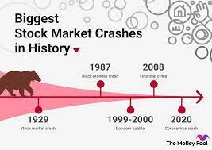

Topic
What if COVID had never spread? What if the stock market had never crashed? Do these major events make food and gas cost more or less? We are hoping to find out.
We have found 2 datasets that has over a decade and a half of data on gas prices and food cpi. We are going to look into what kind of effect they have on each other as well as what effect major events had on them.

Slide 3
Data
We will use two sets of data from Kaggle.com:
Food Prices in US Cities documents the CPI for food monthly from 1952 to July 2022.
Columns Included:
Date
CPI*
US Gasoline and Diesel Retail Prices documents prices for various types of gas weekly from 1995 to January 2021.
Columns Included:
Date
All_grades_all_formulation
All_grades_conventional
All_grades_reformulated
Regular_all_formulation
Regular_conventional
Regular_reformulated
Midgrade_all_formulation
Midgrade_conventional
Midgrade_reformulated
Premium_all_formulation
Premium_conventional
Premium_reformulated
No_2_diesel
*The Consumer Price Index (CPI) is a measure of the average change over time in the prices paid by urban consumers for a market basket of consumer goods and services.

Slide 4
Why?
We are hoping to use this data to eventually determine what food CPI and gas prices would have looked like if COVID had not happened. While we will be looking into other connections between the data and other events as well the main question is “What would gas prices and food prices be like if the years 2020-2022 had been "normal" and rather uneventful on a worldly scale?”
Other questions we’d like to investigate:
What impact did other major events have on gas and food?
Are there some gas prices that were affected over others?
Is there an automatic increase in food when gas inflaces? What about vise versa?

Slide 5
Technologies being used
Data Cleaning and Analysis
Pandas in Jupyter Notebook will be used to clean the data and perform an exploratory analysis. MatPlotLib will be used to visualize the dataset to assist in our exploratory analysis.
Database Storage
The cleaned data will be saved in csv files and will be imported to Postgres.
Machine Learning
We will use SciKitLearn and ExponentialSmoothing from StatsModels to create our models and to predict our "what if" data.
Dashboard
We will use Tableau to visualize our data and to create a dashboard.

Slide 6
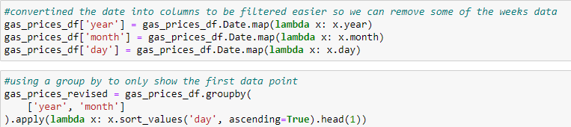

Cleaning the Gas Pricing Data
Before we can dive into our research we had to clean up the gas pricing dataset to match our food CPI dataset. Here are the steps we took to do this:
Checked the datatype and converted so the ‘date’ column was an actual date datatype instead of an object.
The gas pricing dataset had weekly data and the food pricing dataset had monthly data. So we had to convert the weekly data to monthly. We did this by taking the first reference point of each month and saving only that data.*
We also had to make sure that each of the dates started on the first of the month so we could tie them to the food CPI data.*

Slide 7
Cleaning the Food CPI Data
We also need to make a few adjustments to the food cpi dataset to be sure it’s ready for analyzing. Here are the steps we took with this dataset:
Checked the datatype and converted so the ‘date’ column was an actual date datatype instead of an object.
The food CPI had more years of data than the gas pricing. So we consolidated it to only reflect the same date range as the gas price dataset.*
*Change was done on a specific file to be sure the data matches. We also created separate files that held the entirety of each dataset that do not join to each other.

Slide 8
Exploring the Data
Before jumping into specific data points we used matplotlib to create some general graphs to visualize our data.

Slide 9
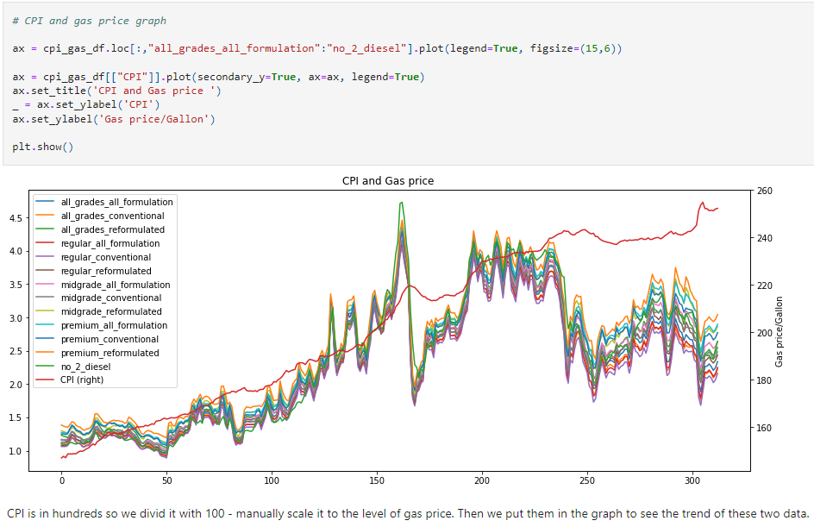

Slide 10
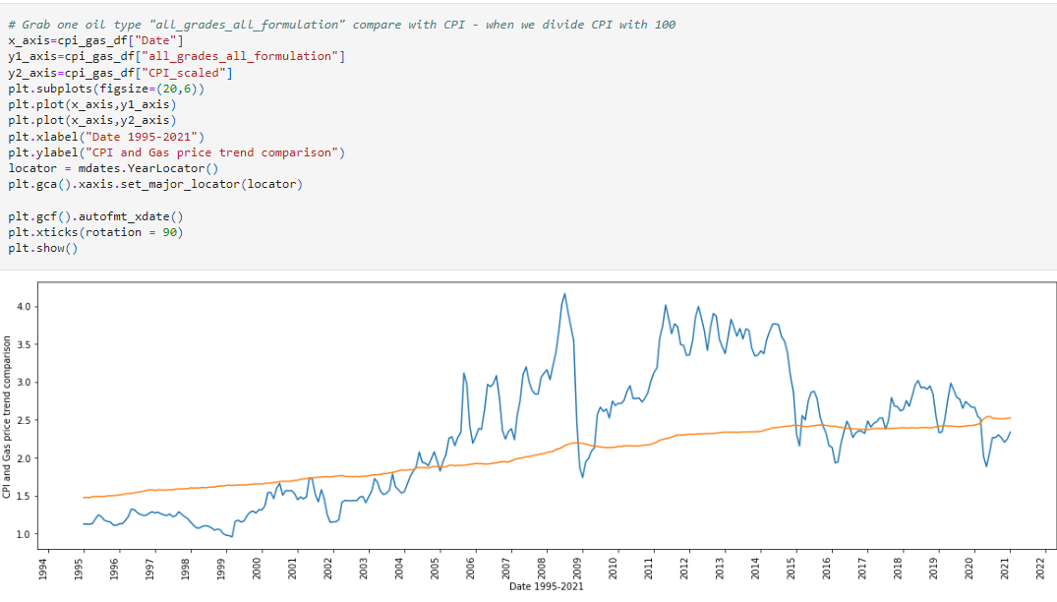

Slide 11
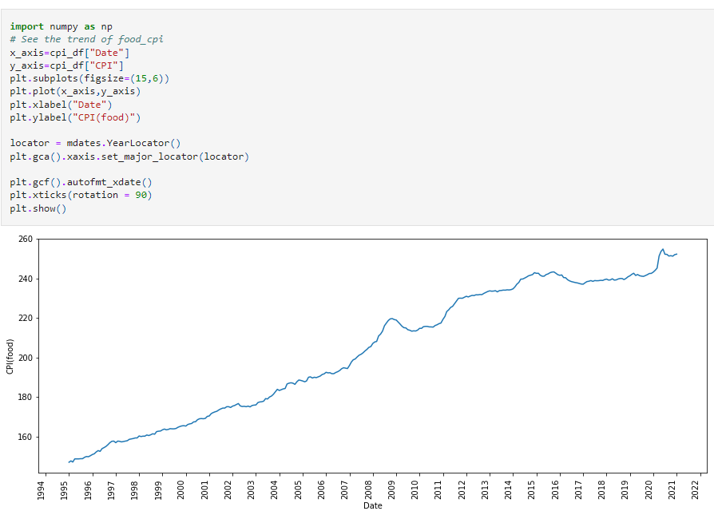

Slide 12
Major USA Events between 1995 - 2021:
September 11, 2001 - Twin Towers were attacked
March 20, 2003 - Beginning of Iraq War
August 29, 2005 - Hurricane Katrina
September 29, 2008 - Stock Market Crash
June 11, 2009 - Swine Flu Pandemic
April 20, 2010 - Deepwater Horizon oil spill
Oct 1, 2013 - Government Shutdown (17 days)
December 20, 2018 - Government Shutdown (35 days)
March 11, 2020 - COVID Pandemic

